Slide 1

Research Progress Record
Enmao Diao
May 14, 2020

Slide 2
Overview
Multimodal controller for generative models
Experiment
Result
Next step

Slide 3
Multimodal controller for generative models
Example
N: batch size, D: input channel size, K: output channel size, C: the number of modes (classes)
Input X (NxD), Output Y (NxK), Weight W (DxK), mode indicator C (NxC) (one-hot vector).
MC (Multimodal Controller) has a codebook E (CxK)
The formulation of multimodal controlled linear layer
Y = XW
Ymc = Y * (CE) (*: element-wise multiplication)

Slide 4
Multimodal controller for generative models
Current baseline models
Variational generative models (Conditional VAE)
Stable results
Conditioning by concatenating trainable embeddings to the first layer of Encoder and Decoder
Autoregressive generative models (Conditional GatedPixelCNN)
Need fine tuning
Conditioning by adding trainable embeddings to GatedPixelCNN
Adversarial generative models (Conditional GAN)
Need fine tuning
Conditioning by concatenating trainable embeddings to the first layer of Generator and Discriminator

Slide 5
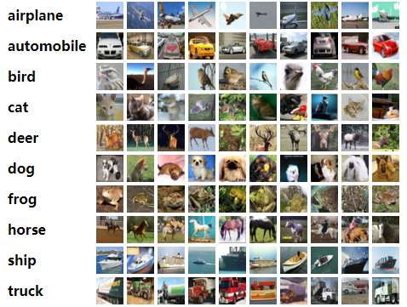
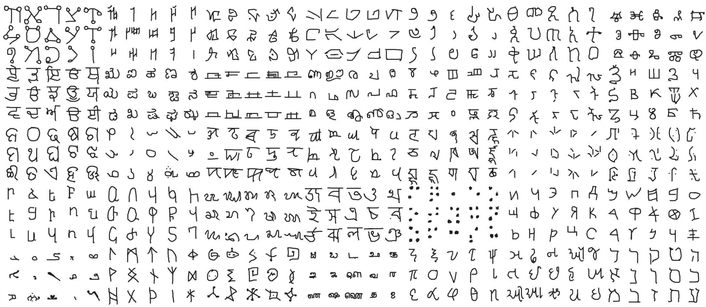
Multimodal controller for generative models
Experiments
Omniglot dataset (https://github.com/brendenlake/omniglot)
CIFAR10 dataset

Slide 6
Multimodal controller for generative models
Quantitative Result
CIFAR10
Model | Inception Score
MCVAE | 3.24
CVAE | 3.43
MCPixelCNN | 4.67
CPixelCNN | 4.72
MCGAN | 7.07
CGAN | 8.16

Slide 7
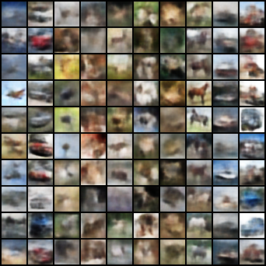
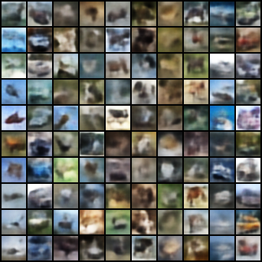
Multimodal controller for generative models
Qualitative Result
CIFAR10
MCVAE CVAE

Slide 8
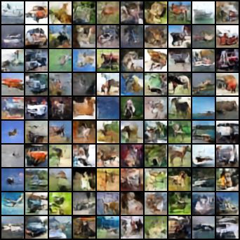
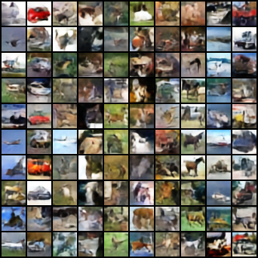
Multimodal controller for generative models
Qualitative Result
CIFAR10
MCPixelCNN CPixelCNN

Slide 9
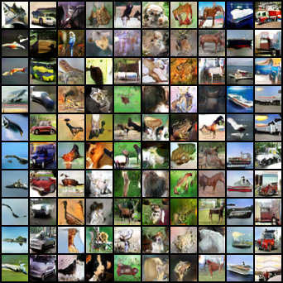
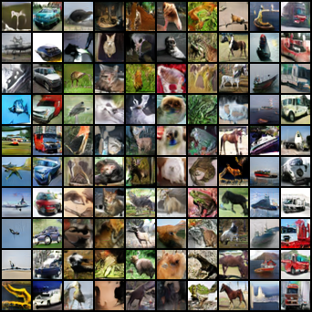
Multimodal controller for generative models
Qualitative Result
CIFAR10
MCGAN CGAN

Slide 10
Multimodal controller for generative models
Quantitative Result
Omniglot
Model | Inception Score
MCVAE | 597
CVAE | 160
MCPixelCNN | 523
CPixelCNN | 570
MCGAN | 792
CGAN | 304

Slide 11
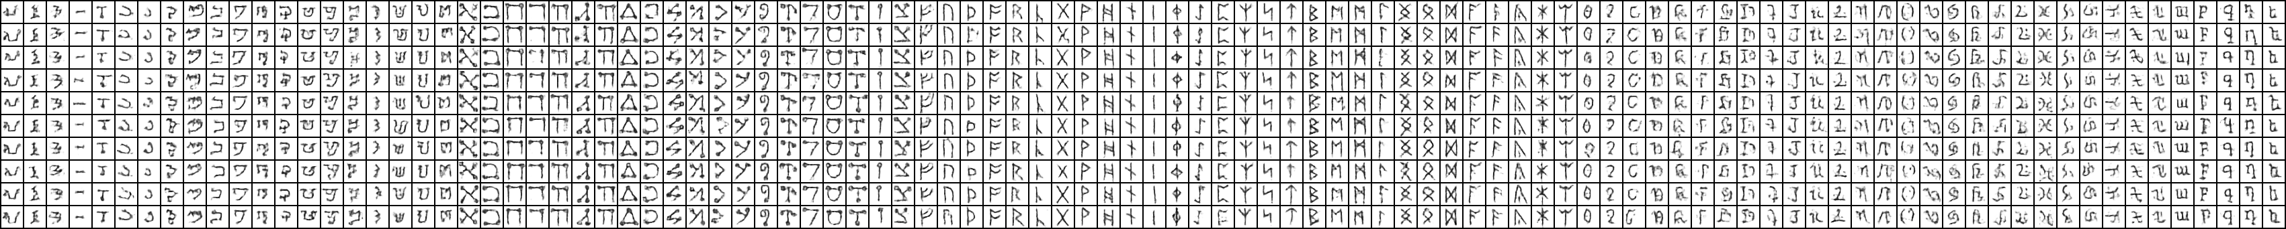
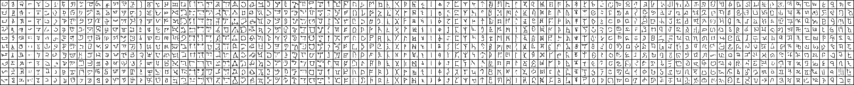
Multimodal controller for generative models
Qualitative Result
CIFAR10
MCVAE
CVAE

Slide 12
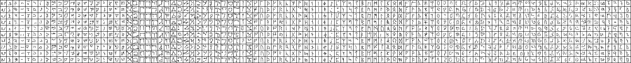
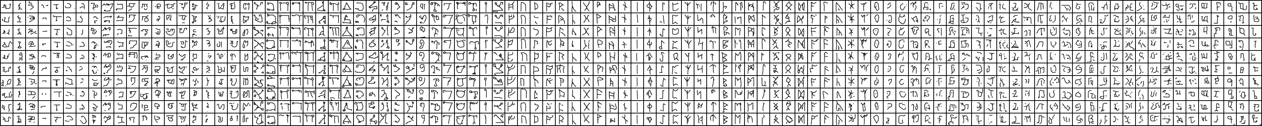
Multimodal controller for generative models
Qualitative Result
CIFAR10
MCPixelCNN
CPixelCNN

Slide 13
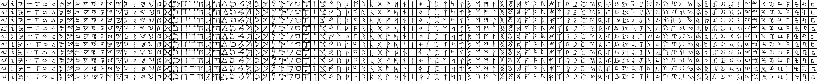
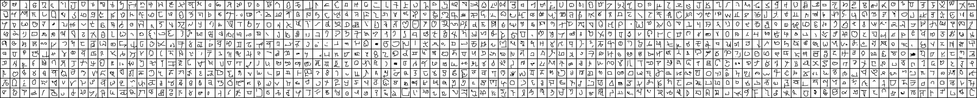
Multimodal controller for generative models
Qualitative Result
CIFAR10
MCGAN
CGAN

Slide 14
Multimodal controller for generative models
Discussion
VAE, PixelCNN, and GAN works fine now
MC generative models is inferior to conditional generative models when the number of modes is small but superior to it when the number of modes is large
When given enough parameters for modeling class-conditional labels like in PixelCNN, conditional models may still achieve comparable performance but it is controversial to discuss where and how many parameters that is needed.

Slide 15
Multimodal controller for generative models
Create new model by changing embeddings for conditional models and multimodal controlled models
For conditional models we use convex combinations to create new embeddings E (CxD)
We set a Dirichlet distribution of size C with equal concentration by default. Then sample C’ times to get a C’xC matrix K where each row sums to 1. The new embedding E’ = KE
For multimodal controlled models
Randomly re-initialized codebook
Genetic idea: single-point or uniform crossover with mutation
Randomly select two parents
Then use single-point or uniform crossover to create children
Mutate code with probability 1/D
Lack quantitative way of evaluating results

Slide 16
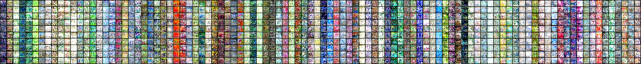
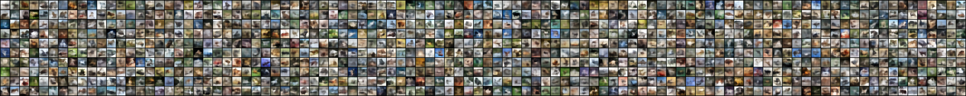
Multimodal controller for generative models
Qualitative Result
CIFAR10
MCVAE
CVAE

Slide 17
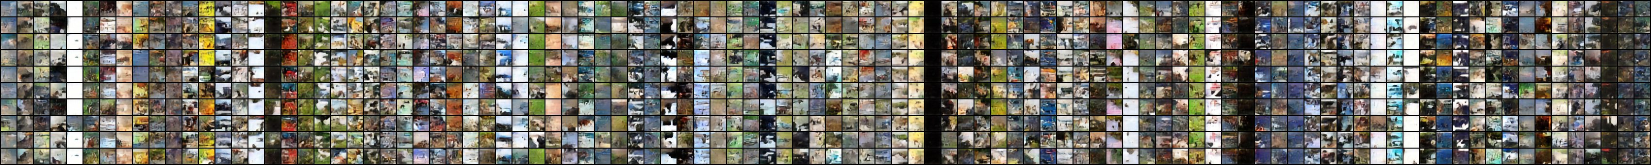
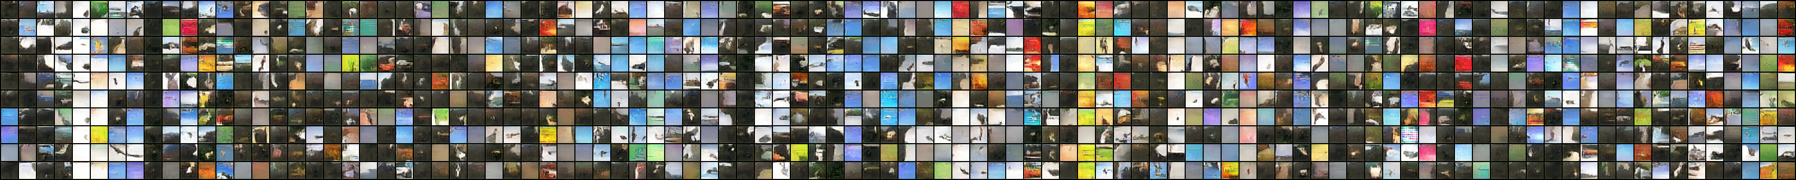
Multimodal controller for generative models
Qualitative Result
CIFAR10
MCPixelCNN
CPixelCNN

Slide 18
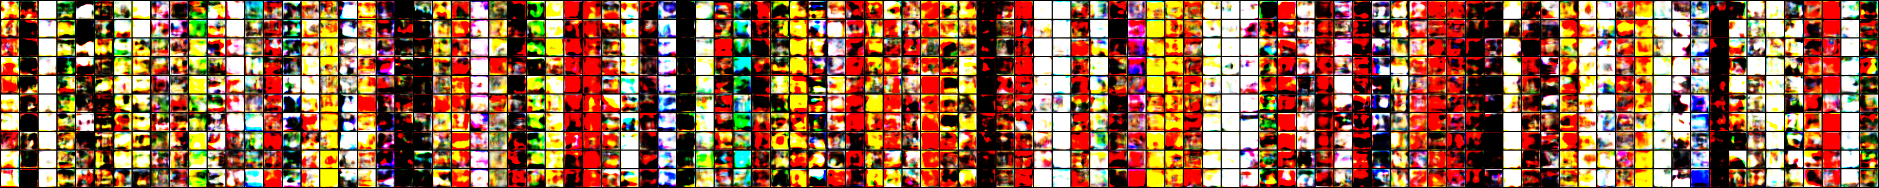
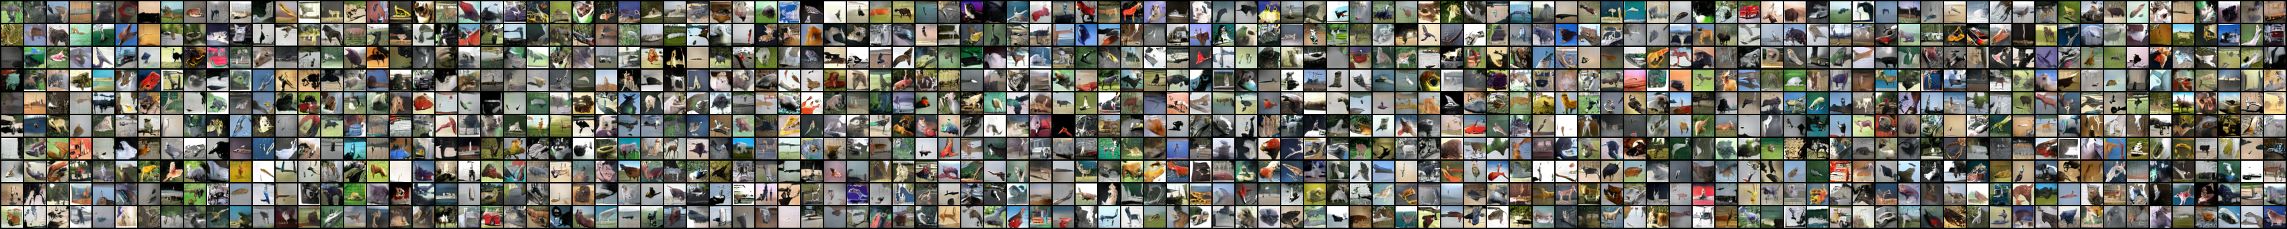
Multimodal controller for generative models
Qualitative Result
CIFAR10
MCGAN
CGAN

Slide 19
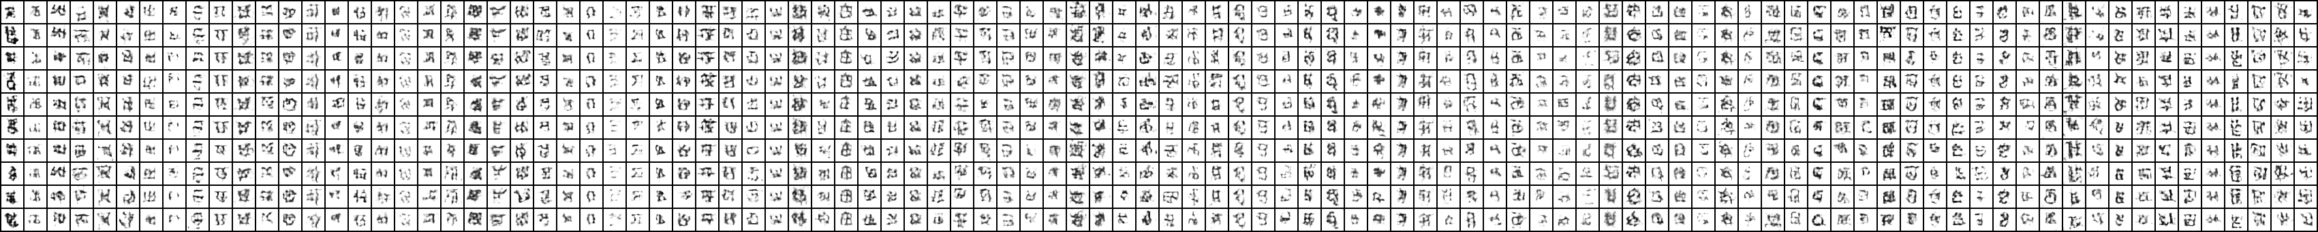
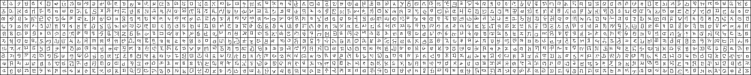
Multimodal controller for generative models
Qualitative Result
CIFAR10
MCVAE
CVAE

Slide 20
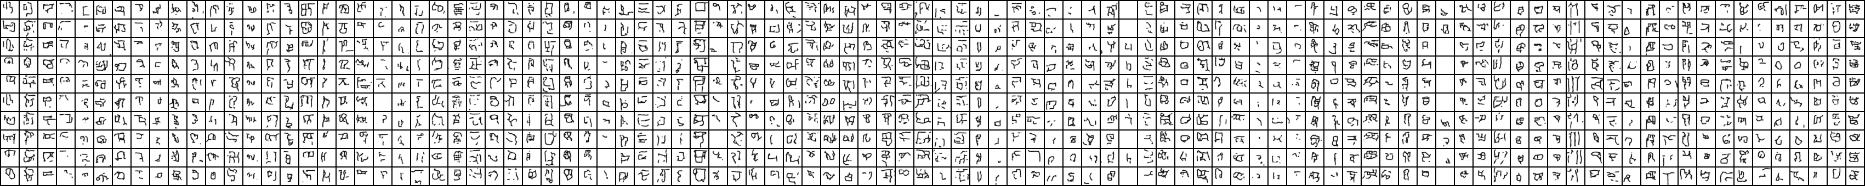
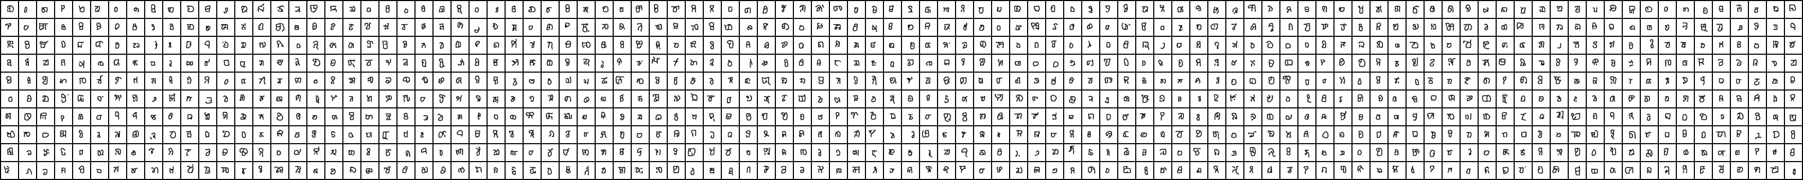
Multimodal controller for generative models
Qualitative Result
CIFAR10
MCPixelCNN
CPixelCNN

Slide 21
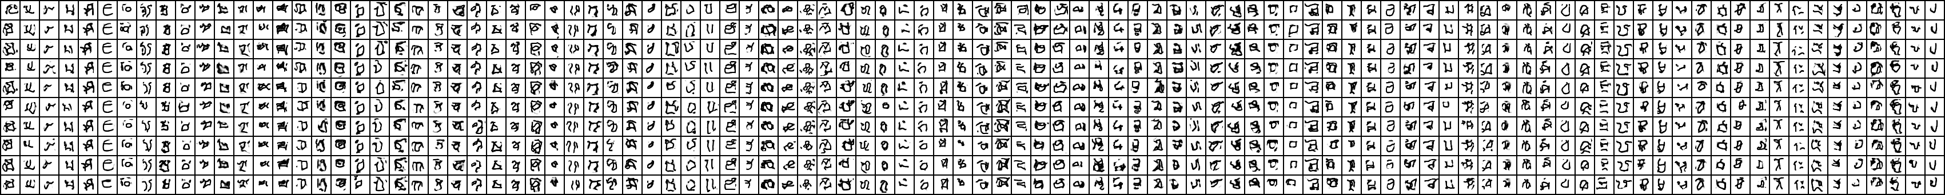
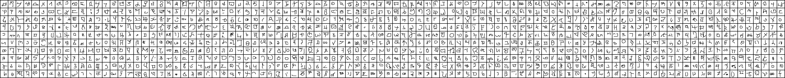
Multimodal controller for generative models
Qualitative Result
CIFAR10
MCGAN
CGAN

Slide 22
Multimodal controller for generative models
Discussion
Convex combination does not work with conditional generative models
For MC generative models trained with small classes size, randomly sampled codebook does not work either
We find randomly sampled codebook for dataset with large classes size promising
Randomly sampled codebook and genetic created codebook virtually not much difference

Slide 23
Multimodal controller for generative models
Image Transition
Given a fixed latent code in VAE and GAN we can gradually transform a image from one class to the other
Conditional generative models achieve this by interpolating two vectors of embeddings with a step size \alpha
MC generative models achieve this by replacing gradually replacing codes of one class from the other class

Slide 24
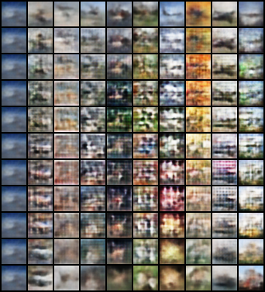
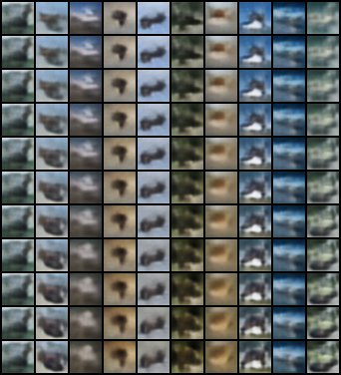
Multimodal controller for generative models
Qualitative Result
CIFAR10
MCVAE
CVAE

Slide 25
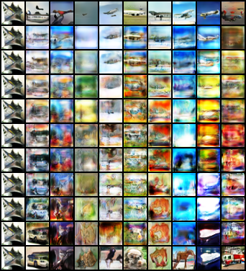
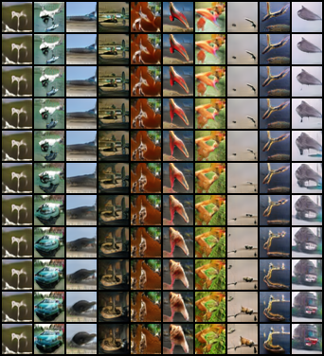
Multimodal controller for generative models
Qualitative Result
CIFAR10
MCGAN
CGAN

Slide 26
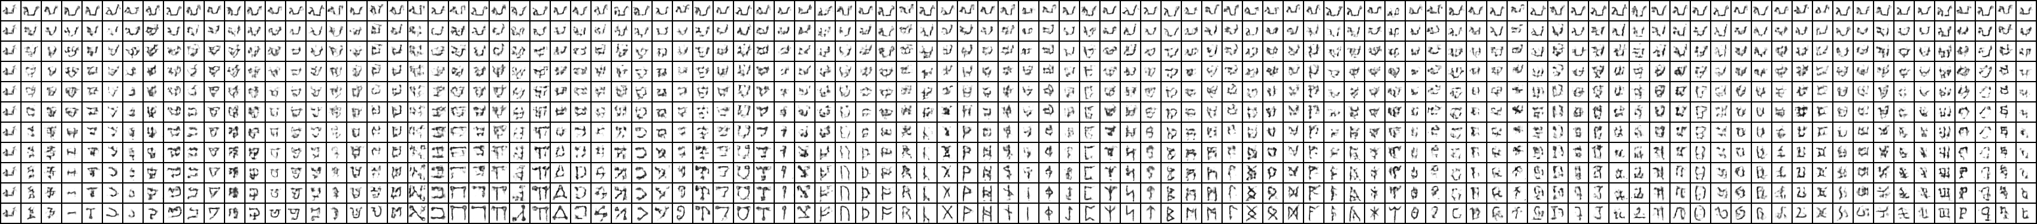
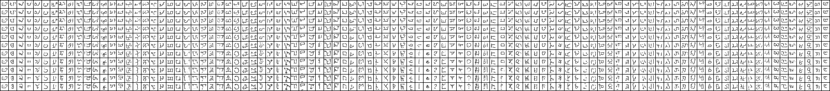
Multimodal controller for generative models
Qualitative Result
CIFAR10
MCVAE
CVAE

Slide 27
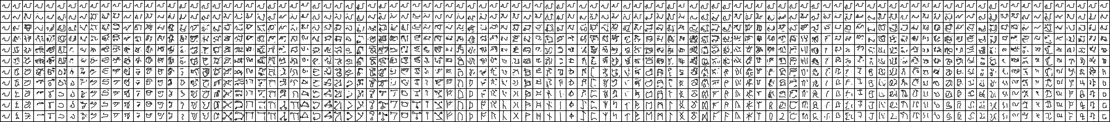
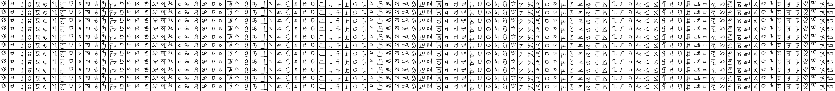
Multimodal controller for generative models
Qualitative Result
CIFAR10
MCGAN
CGAN

Slide 28
Multimodal controller for generative models
Next Step
MC Normalization Flow
Base model: Glow
Condtional Glow can generate class-condtional images by training a prior
MC Glow train without prior but with MC
Complete random experiments and wrap up final quantitative and qualitative results
Completed: VAE PixelCNN
Running: GAN
Lack of codes to process result for now
Use ImageNet 64x64 dataset
Not realistic for random experiments. Hoping for just one experiment for all four models. The result would be interesting if we can create new modes of RGB images given 1000 training modes.
May need extra GPU from Azure

